Slide 1
Decision Forests
About Authors

Slide 2
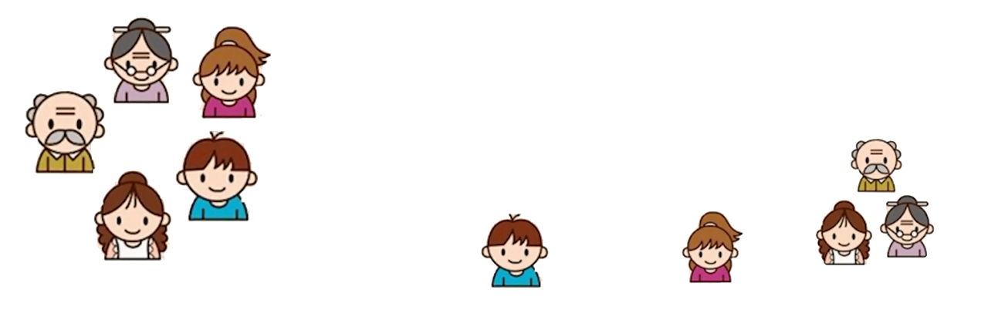
Gradient Boosting
Input: age, gender, occupation etc
Does the person like computer games?
Age < 15
Yes
No
Is male?
Yes
No
Prediction score in each leaf
+2
+0.1
-1

Slide 3
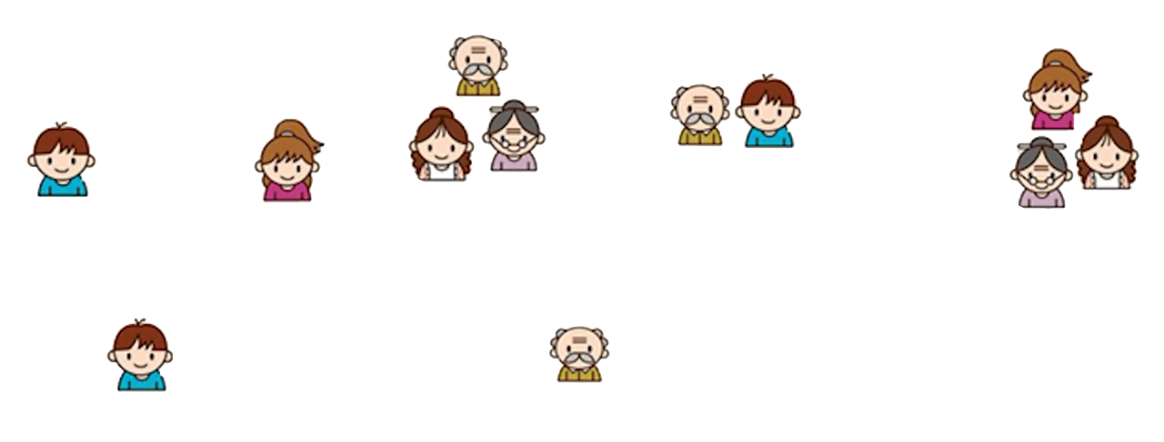
Tree 1
Tree 2
Age < 15
Use computer daily?
Yes
No
Yes
No
Is male?
Yes
No
+2
+0.1
-1
+0.9
-0.9
f ( )=2+0.9=2.9
f ( )=-1+0.9=-0.1

